Slide 1
A
SEMINAR PRESENTAION
ON THE TOPIC:
THE DYNAMICS OF ANTIOXIDANT IN ANIMAL NUTRITION
WRITTEN BY
UKPONG, MFONISO INIOBONG
AK18/AGR/ANS/0
SUPERVISED BY
DR. OFONINYENE USORO
DEPARTMENT OF ANIMAL SCIENCE
FACULTY OF AGRICULTURE
AKWA IBOM STATE UNIVERSITY
OBIO AKPA CAMPUS
JUNE, 2023

Slide 2
SUMMARY
Antioxidants are compounds that serve the function of preventing harmful oxidation processes in cells and tissues. The addition of antioxidants to animal feed has been shown to have numerous benefits. Studies have shown that the incorporation of antioxidants in the diet can increase growth rates, improve feed efficiency, enhance the immune system, reduce stress, and improve overall animal health. Additionally, the addition of antioxidants to animal feed has been found to reduce the risk of meat and milk spoilage and extend their shelf life.

Slide 3
INTRODUCTION
Antioxidants are compounds that serve the function of preventing harmful oxidation processes in cells and tissues.
The primary function of antioxidants in animal nutrition is to neutralize harmful free radicals that are produced during oxidative metabolism.
These free radicals can cause cellular damage and lead to various health problems, including inflammation, tissue damage, and increased risk of disease.
Antioxidants act as scavengers, neutralizing the excess free radicals and protecting the cells from their harmful effects (El-Senousey et al., 2015).
They have been found to play a significant role in maintaining the health and well-being of animals, particularly through their inclusion in animal feed (Diao et al., 2019; Choe et al., 2017).

Slide 4
OBJECTIVES OF THE STUDY
The objective of this seminar is to review the roles of antioxidants on animals.

Slide 5
CLASSES OF ANTIOXIDANT
Natural antioxidants: These are derived from natural sources, such as vitamins, minerals, and enzymes. They include ascorbic acid (Vitamin C), tocopherols (Vitamin E), carotenoids (beta-carotene, lycopene), and trace elements (selenium, copper, zinc) (Chowdhury et al., 2009).
Synthetic antioxidants: These are artificially produced antioxidants which include butylated hydroxyanisole (BHA), butylated hydroxytoluene (BHT), and ethoxyquin (EQ) which are commonly used in animal feed to prevent oxidative rancidity (Hafez and Attia, 2017).
Plant-derived antioxidants: These are obtained from plant extracts that are rich in phenolic compounds, flavonoids, and polyphenols. Examples include grape seed extract, green tea extract, and rosemary extract (Halliwell & Gutteridge, 2015)

Slide 6
ROLES OF ANTIOXIDANTS ON ANIMALS’ GROWTH RATE
Antioxidants are essential components of animal diets that are involved in the regulation of various physiological processes. Antioxidants are known to improve growth rates in animals by combating oxidative stress, which is a state of imbalance between the production of reactive oxygen species (ROS) and antioxidant defenses. Oxidative stress can lead to the damage of various cellular components, including DNA, proteins, and lipids, which can impair metabolic and physiological functions, as well as the immune system. Several studies have indicated that antioxidants play a crucial role in improving growth rate in animal nutrition. For instance, a study by Liu et al., (2017) investigated the effects of dietary supplementation of vitamin E and selenium on the growth performance of broiler chickens. The study found that dietary vitamin E and selenium supplementation significantly improved the growth rate and feed conversion ratio of broiler chickens and Zhang et al., (2019) concurred.

Slide 7
Source: Liu et al., (2017)

Slide 8
ROLES OF ANTIOXIDANTS ON ANIMALS’ MEAT QUALITY
In the context of animal nutrition, antioxidants are used to prevent the formation of undesirable substances that can cause deterioration of meat quality. Numerous studies have investigated the effect of antioxidants on meat quality, with many showing significant improvements in various aspects of meat quality. A study conducted by Jo et al., (2018) investigated the effect of green tea extract on the quality of pork. The study found that green tea extract improved meat sensory properties, including tenderness, juiciness, and flavor by enhancing oxidative stability.

Slide 9
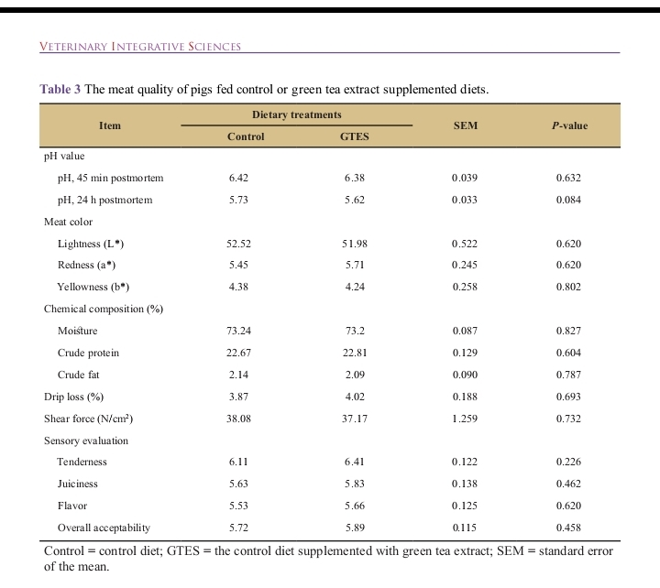
Table 2: Effect of meat quality of pigs fed diet supplemented with green tea extract (antioxidant) Source: Jo et al., (2018)

Slide 10
ROLES OF ANTIOXIDANTS ON EGG QUALITY
Antioxidants are compounds that can prevent or neutralize the damaging effects of free radicals, which can cause oxidative stress and damage the cells in the body. In poultry, oxidative stress can lead to poor egg quality, reduced egg production, and increased mortality rates. Several research projects have been carried out to evaluate the efficacy of various antioxidants in improving egg quality in poultry. A study by Zhang et al., (2018) evaluated the effects of adding dietary antioxidants (vitamin E) on egg quality in laying hens. The results showed that dietary supplementation with antioxidants improved egg quality, including eggshell thickness, egg yolk color, and haugh unit concurred Wang et al., (2019).

Slide 11
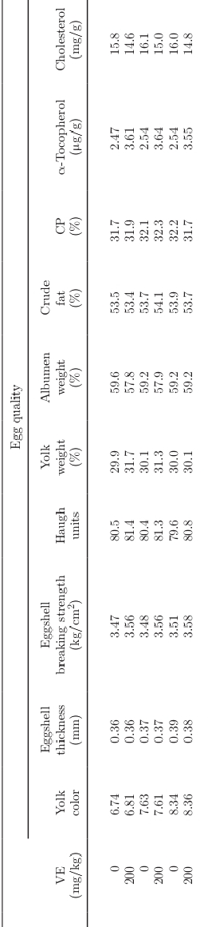
Table 3: Effect of Vitamin E (antioxidant) on egg quality o laying hens Source: Zhang et al., (2018)

Slide 12
ROLES OF ANTIOXIDANTS ON ANIMALS’ REPRODUCTIVE HEALTH
In animal nutrition, antioxidants are known to improve reproductive health by reducing oxidative stress and improving overall fertility. Some studies have demonstrated the effectiveness of antioxidants in improving reproductive health in animal nutrition. A study was conducted by Gikonyo et al., (2007) to investigate the effect of supplementation with vitamin E and selenium on the fertility of dairy cows. The study found that supplementation with these two antioxidants significantly increased the conception rate of the cows. This indicates that antioxidants can improve reproductive health and reduce the occurrence of infertility in dairy cows. Another study was conducted by Takagi et al., (2011) to investigate the effect of dietary antioxidant supplementation on reproductive performance and oxidative status in sows. The study found that supplementation with vitamin E and selenium significantly improved the reproductive performance, including a higher number of piglets born and increased litter weights.

Slide 13
ROLES OF ANTIOXIDANTS ON ANIMALS’ IMMUNITY
Antioxidants play a crucial role in boosting the immune system of animals by reducing oxidative stress and enhancing their overall health and well-being. This is accomplished by neutralizing free radicals, which are reactive molecules that can damage cells and tissues leading to inflammation, chronic diseases, and impaired immune function. Various research studies have demonstrated the effectiveness of antioxidants in improving immune function in animals. A study conducted by Abo El-Maaty et al., (2017) evaluated the effects of adding vitamin E to the diet of Japanese quails. The study observed that vitamin E supplementation significantly increased the immune response, including the antibody titer, phagocytic index, and lymphocyte proliferation and lowered mortality.

Slide 15
CONCLUSION
Conclusively, antioxidants are vital components of animal nutrition, playing a critical role in maintaining animal health, improving growth rates, and enhancing overall productivity. As such, their inclusion in animal feed is essential to ensure optimal animal health and well-being. Hence, the dynamics of antioxidant use in animal nutrition depend largely on the animal species, age, and physiological status. The optimal dosage and type of antioxidant required also vary depending on the specific needs of the animal. Regular monitoring and adjustment of the antioxidant supplementation levels are essential to ensure optimal health and performance.

Slide 16
REFERENCES
Abo El-Maaty, H. M., El-Saadany, S. S., El-Naseery, N. I., & Shafey, T. M. (2017). Immunological and antioxidant status improvement in Japanese quails (Coturnix coturnix japonica) upon vitamin E administration. Egyptian Journal of Animal Production, 54(1), 69-75.
Al-Daraji, H. J., Mahdi, L. H., Naser, T. A., & Al-Marzooqi, W. S. (2016). Effect of vitamin E on some reproductive parameters in male goats. Journal of Livestock science, 7(1), 27-34.
Araújo, F. R., Peixoto, G. C. X., Pinho, R. O., Silva, A. F., Oliveira, R. A. B., Oliveira, M. A. L., ... & Moura, A. A. (2015). Effects of vitamin E and selenium on sperm quality in stallions. Animal Reproduction Science, 152, 26-33.
Choe, J. H., Kim, H. Y., & Lee, M. A. (2018). Effects of grape seed extract on quality characteristics of pork. Meat science, 145, 220-226.
Choe, J., Kim, H., & Choi, Y. (2017). Thymol essential oil supplementation improves growth performance and meat quality in finishing pigs. Animal Science Journal, 88(7), 1047–1053. doi: 10.1111/asj.12733
Davis, M. E., Brown, D. C., & Maxwell, C. V. (2015). The effect of vitamin E and selenium supplementation on the viability and longevity of commercial broiler breeder hens. Poultry Science, 94(11), 2728-2735.
Diao, H., Cao, W., Guo, J., Ye, X., Liu, S., Yang, X., & Wang, J. (2019). Grape seed proanthocyanidin extract improves chicken meat tenderness via regulating protein degradation and antioxidation capacity. International journal of molecular sciences, 20(18), 4424.
Duan, X., Li, J., Yang, Y., Li, F., & Li, K. (2018). Dietary tea polyphenols improve growth performance and meat quality in yellow-feathered broilers through antioxidant capacity and oxidative stability. Journal of animal science and biotechnology, 9(1), 70.
El-Senousey, H. K., Chen, B., & Wang, J. (2015). Effect of dietary tocopherol on immune response of broiler chickens following exposure to high ambient temperature. Poultry Science, 94(12), 2891-2900.
Xiong, Y. L., Chen, X., & Chen, Y. J. (2018). Effects of dietary selenium supplementation on meat quality and muscle selenium concentration in broilers. Food science and biotechnology, 27(6), 1639-1646.
Xu, L., Zhang, L., Xia, W., & Wu, X. (2018). Effects of astaxanthin on antioxidant and immune response in laying hens. Poultry Science, 97(9), 3246-3254.
Yilmaz, S., Ergün, S., & Kocaman, E. M. (2016). The effects of dietary vitamin C on the growth performance and immune response of rainbow trout (Oncorhynchus mykiss). Aquaculture International, 24(2), 585–594. doi: 10.1007/s10499-015-9967-4
Zhang, D. C., Zhang, W. H., Gao, H. J., Li, P., Li, J., & Cui, G. F. (2018). Effect of selenium and vitamin E supplementation on reproductive performance and antioxidant capacity of breeding ewes. Journal of Animal Physiology and Animal Nutrition, 102(3), e741-e745.
Zhang, K., Li, J., Qi, W., Zhang, W., Jiang, J., & Wang, Q. (2019). Lycopene improves growth performance, antioxidant status, and immune function in ducklings. Livestock Science, 223, 89–94. doi: 10.1016/j.livsci.2019.03.011

Slide 17
THANK YOU!!

